Slide 1

Introduction to Programming and Coding
Muhammad Arif
http://muharif.net

Slide 2
Materials
I have slight problem with KEATS
You can download the entire materials of this session and the workshops here:
https://muharif.github.io/MicrobiomeKCL2020/

Slide 3

Quiz: Why are you learning programming?

Slide 4

Main Question: What is the best way to learn programming?

Slide 5




Case: Time for Tea!
Computer!
Make me tea in 150ml cup!
Convey
Result

Slide 6



What is programming?
Conveying a series of commands, from the programmer, to computer to perform set of task and solve problems or produce results
Computer!
Make me tea in 150ml cup!
Command(s)
Convey
Result
Programmer
Coder
Computer
Interpreter
Compiler
Results
Software
Web
Apps

Slide 7

Commands
Computer!
Make me tea in 150ml cup!
Start
Take 1 bag of tea
Components in commands:
Set of instructions in an order (Sequences)
Making choices (Selections)
Doing things multiple times (Repetitions)
Processes in the commands --> Algorithm
Conveyed to the computer via programming languages
Put it in the cup
Add 150ml of hot water
No
With Milk?
Yes
Add milk
Enough?
No
Yes
Serve

Slide 8















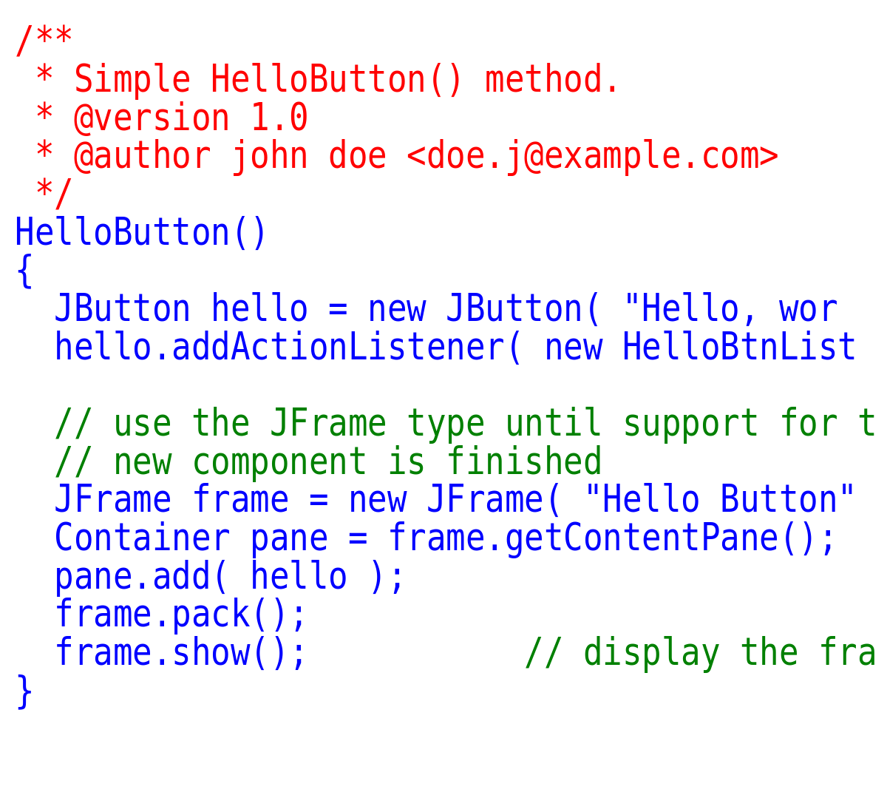



Programming Languages
Understandable by both the programmer and the computer
Depending on the need and expectation of the programmer
Can be compiled and interpreted by the computer
Web
Apps
Data Analysis
Others
01100010011100110
Computer!
Make me tea in 150ml cup!
Convey
Result

Slide 9
Components in programming languages
Start
Take 1 bag of tea
Put it in the cup
Keywords
Example Code (Pseudocode)
DO Take 1 bag of tea
DO Put it in the cup
DO Add 150ml of hot water
CONSTANT milk = 0
IF with milk
THEN milk = milk + 1
ELSE serve
WHILE (milk < 10)
OR (milk == enough)
milk = milk + 1
Do …
While
If … then … else …
Add 150ml of hot water
Str
Float
Int
No
With Milk?
Operators
And
Or
==
>
<
Yes
/
*
+
-
Add Milk
Syntax
Order
Enough?
No
Typos
Yes
Serve

Slide 10

Components in programming languages
Start
Take 1 bag of tea
Put it in the cup
Keywords
Example Code (Pseudocode)
DO Take 1 bag of tea
DO Put it in the cup
DO Add 150ml of hot water
CONSTANT milk = 0
IF with milk
THEN milk = milk + 1
ELSE serve
WHILE (milk < 10)
OR (milk == enough)
milk = milk + 1
Do …
While
Put it in the cup
If … then … else …
Ta ett påste
Add 150ml of hot water
Str
Float
Int
No
With Milk?
Operators
Take 1 bag of tea
Put it in the cup
And
Or
==
>
<
Yes
/
*
+
-
Add Milk
Syntax
Order
Enough?
No
Typos
Yes
Serve

Slide 11
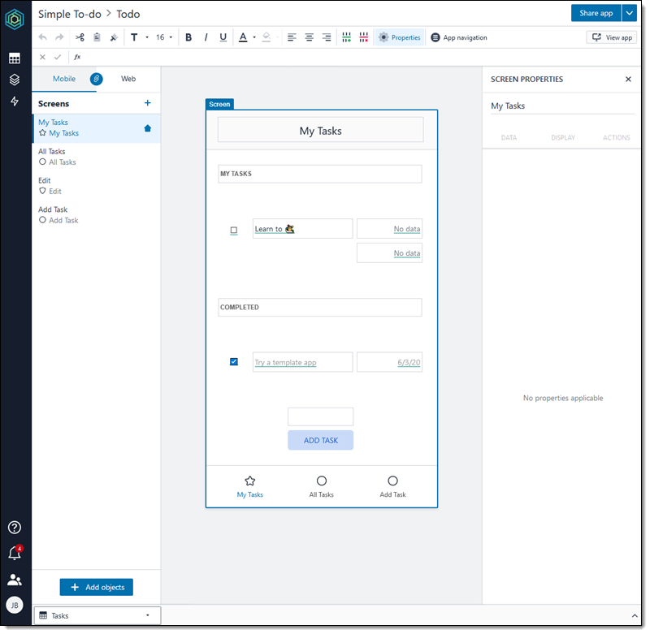



Low- dan No-code
Do we have to write codes?
Nope!
Especially to make web or apps
Similar to puzzle or making presentation

Slide 12
Revisit
Computer!
Make me tea in 150ml cup!
Command(s)
01100010011100110
Convey
Result
DO Take 1 bag of tea
DO Put it in the cup
DO Add 150ml of hot water
CONSTANT milk = 0
IF with milk
THEN milk = milk + 1
ELSE serve
WHILE (milk < 10)
OR (milk == enough)
milk = milk + 1
Programmer
Coder
Computer
Interpreter
Compiler
Results
Software
Web
Apps

Slide 13

Pertanyaan 1: Bagaimana cara terbaik belajar programming/pemrograman?

Slide 14
Quiz: Why are you learning programming?

Slide 15

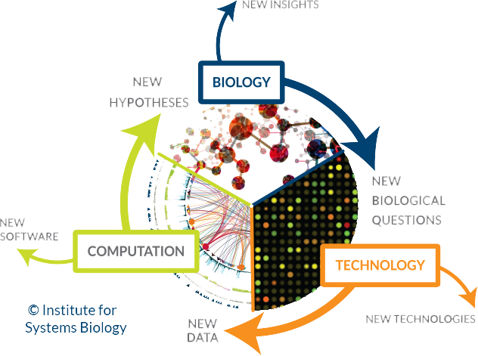
Data Analysis
In the era of big data and machine learning, data science has become a very popular subject
In biology, data analysis has become an integral part in research

Slide 16


Data Analysis in Biology
Complexity and Important Problems
Increase of Computational Power
Huge Amount of Data
Computational Biology
Systems Biology
Multi-discipline Collaboration
The need for efficient solution

Slide 17
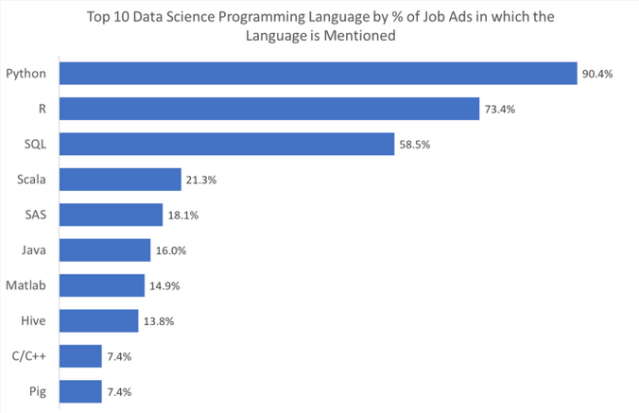
R in Biology
R is one of the most famous programming language in biology for data analysis
Why R?
Easy to use
Tons of readily available packages
Big biology community
Why not just use excel?
R is free
R is simpler and faster
R is more scalable
R is easier to be automatized
Source

Slide 18
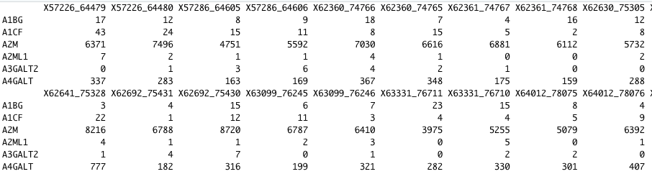
R – Data manipulation
Data Import and Export
Text and Excel files
Raw data from machine (with packages)
Data Manipulation
Listing, subsetting
Merging, Reshaping, imputing

Slide 19
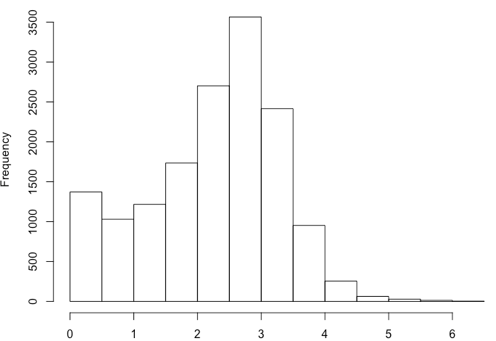
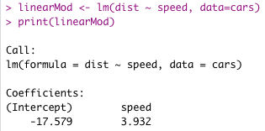
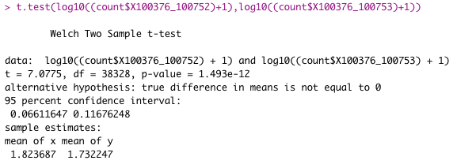
R – Data Analysis
Descriptive Statistics
Statistical tests
Regressions and Correlations
Biological data analysis (Transcriptomics, Proteins, etc)

Slide 20
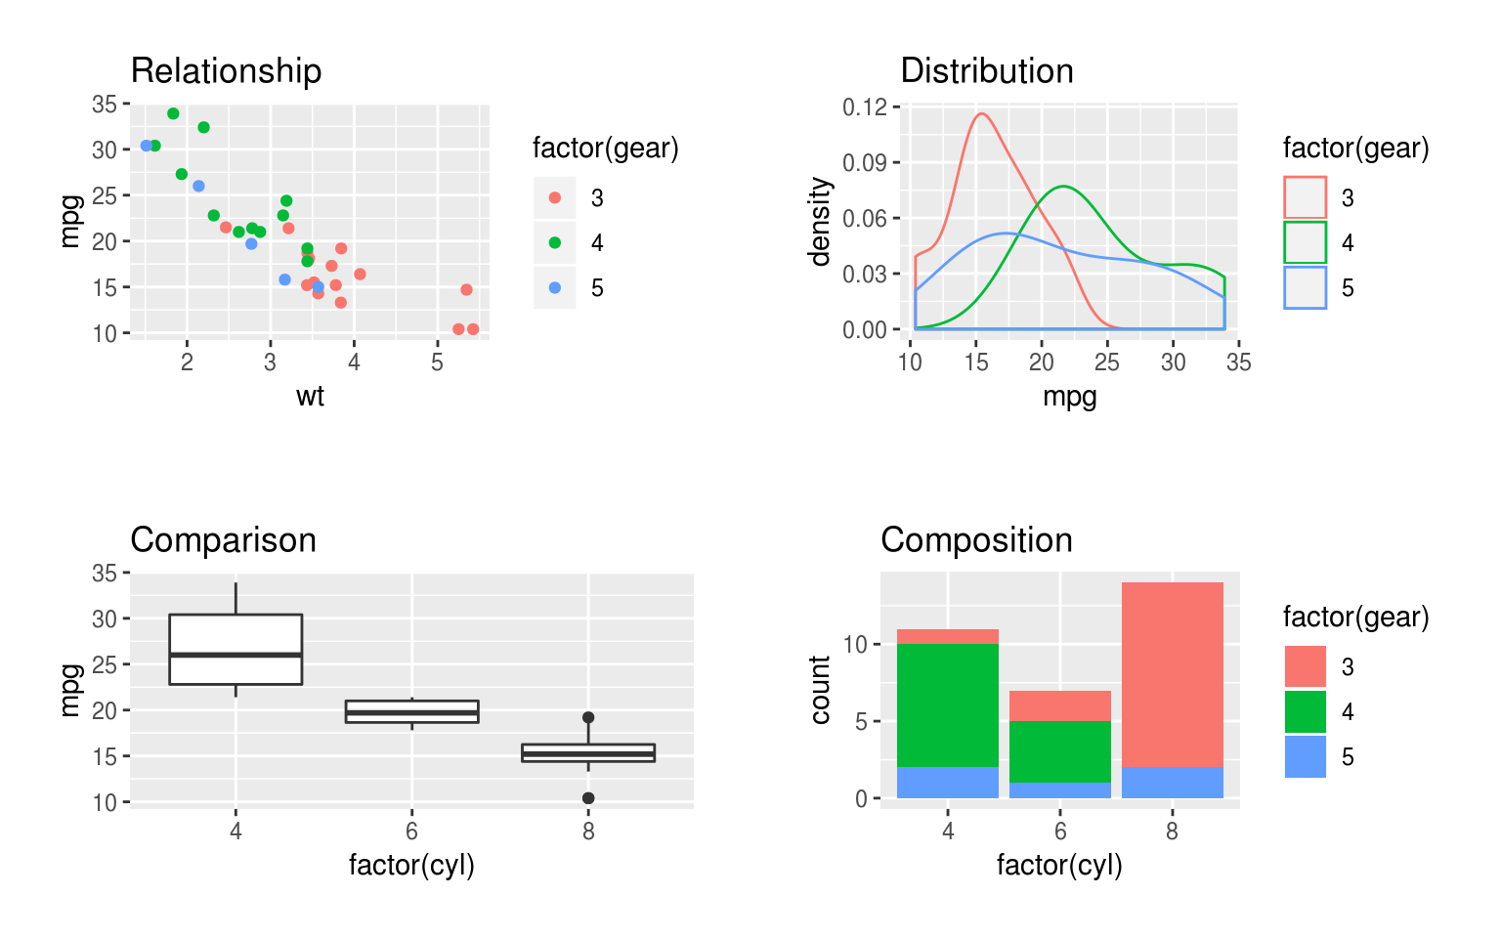
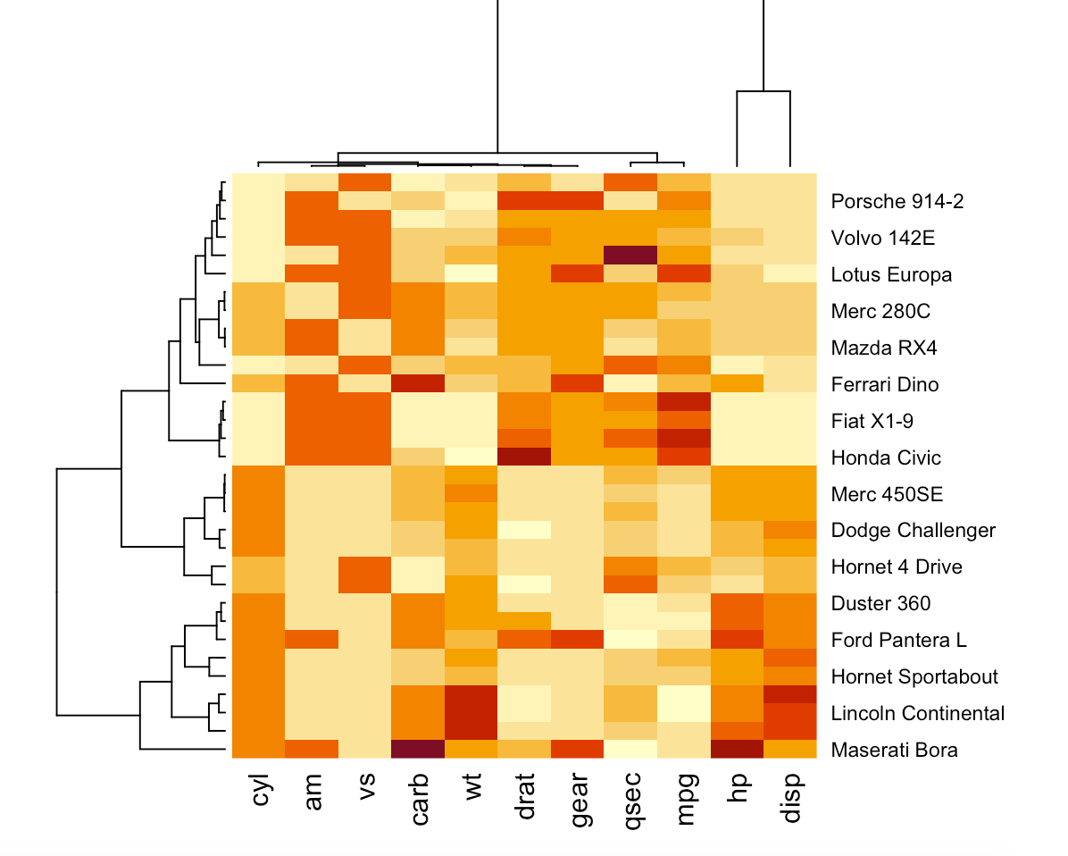
R – Data Visualization
Powerful R package for visualization: ggplot2

Slide 21
What’s next? Nothing better than trying it yourself!
Final message:
Programming logic is much more important compared to programming language

Slide 22
Workshops
Install R and R studio!
Day 1:
Arithmatic and logical operations
Syntax
Data type
Functions
Day 2:
Vectors
Matrices
Dataframes
Descriptive stats
Plotting
Day 3:
Statistical analysis
Combination of Day 1-3
Notes:
First 20-30mins: Examples and explanations about the exercises
The rest of the time: Hands-on time! Take your time, I will be here to answer questions.
Try to understand each line of codes that you see/write.
Follow the exercises and write your answers after each questions
Google is your best friend :)
Bonus: If you write comments explaining how the code works

Slide 23
Thank You!
Muhammad Arif
Contact Me: http://muharif.net

Slide 24
Misconceptions
Assumptions
Reality
Programming language is the most important to learn
Programming Logic is the most important
Must be a math genious
Many libraries/modules to help
Hard and boring
It’s like playing games, fun!
Must remember syntaxes
No, just google it
Must write 1M codes?
Low- and no-code

Slide 25
Starting Points!
Start
Take 1 bag of tea
Remove all misconceptions
Define a goal
Sharpen programming logic
Define big steps
Split it into smaller processes
Connect the processes one by one
Implement it!
Choose the most suitable programming languange
Implement our idea one process at a time
Best friend? Google!
Put it in the cup
Add 150ml of hot water
No
With Milk?
Yes
Add Milk
Web
Apps
Data Analysis
Others
No
Enough?
Yes
Serve

